Slide 1
Selenium Grid
N.Rajendra

Slide 2
Why?
To run your tests against multiple browsers, multiple versions of browser, and browsers running on different operating systems.
To reduce the time it takes for the test suite to complete a test pass.

Slide 3
What?
Selenium-Grid allows you run your tests on different machines against different browsers in parallel. That is, running multiple tests at the same time against different machines running different browsers and operating systems. Essentially, Selenium-Grid support distributed test execution. It allows for running your tests in a distributed test execution environment.

Slide 4
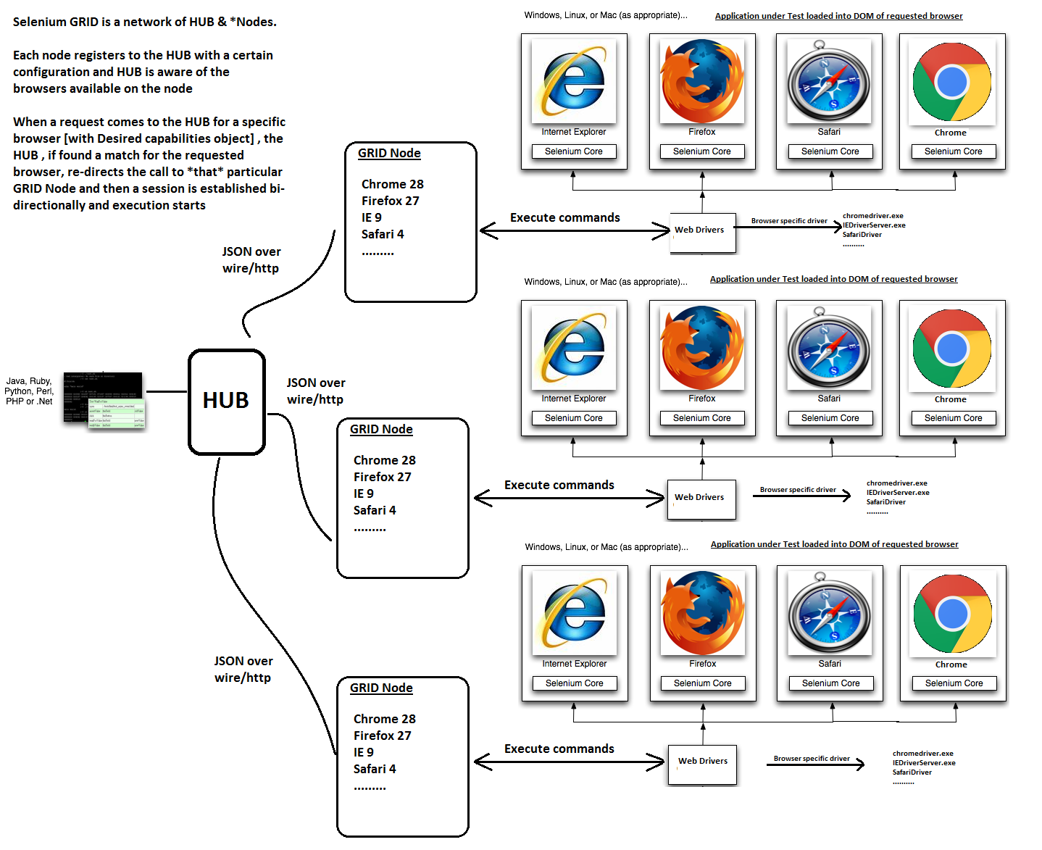
How?

